Slide 1
TRANS-LEK
DARTH CODERS

Slide 2
PROBLEM

Slide 3


Slide 4


Slide 5
SYSTEM

Slide 6
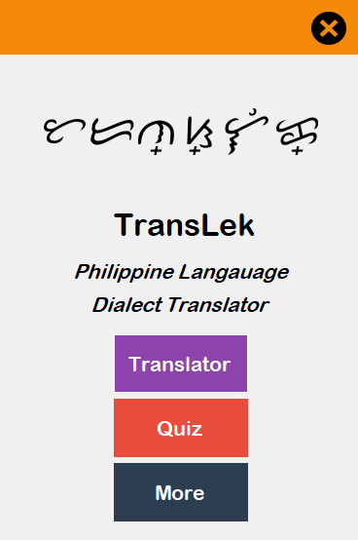
WELCOME AREA

Slide 7
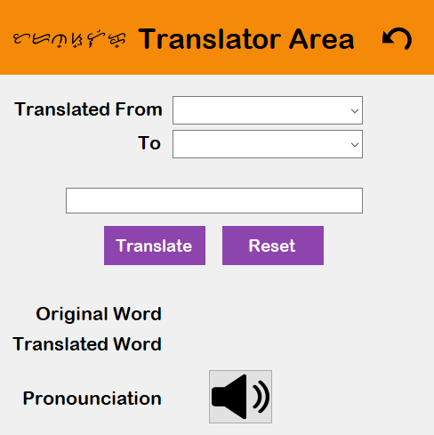
TRANSLATOR AREA

Slide 8
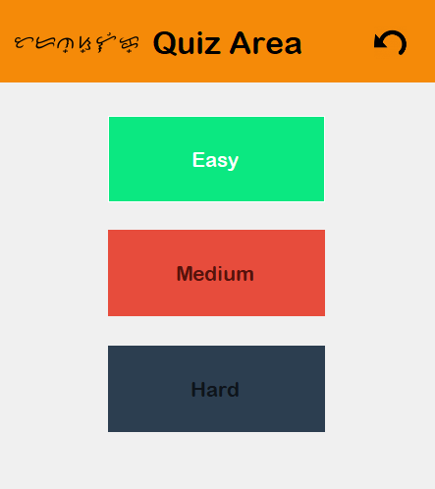
QUIZ AREA

Slide 9
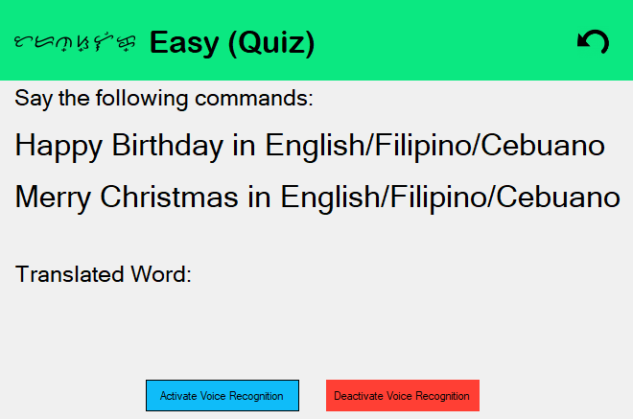
EASY QUIZ

Slide 10
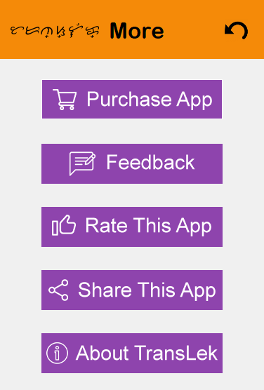
MORE AREA

Slide 11
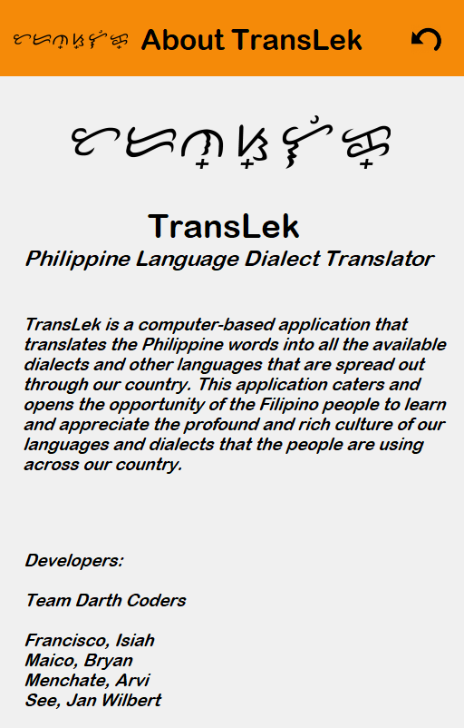
ABOUT AREA

Slide 12
BENEFITS

Slide 13






Slide 14
FUTURE PLANS

Slide 15






